Slide 1



303105104 - Computational Thinking for Structured Design-1
Prof. Neelam Agrawal, Assistant Professor Computer Science & Engineering

Slide 2
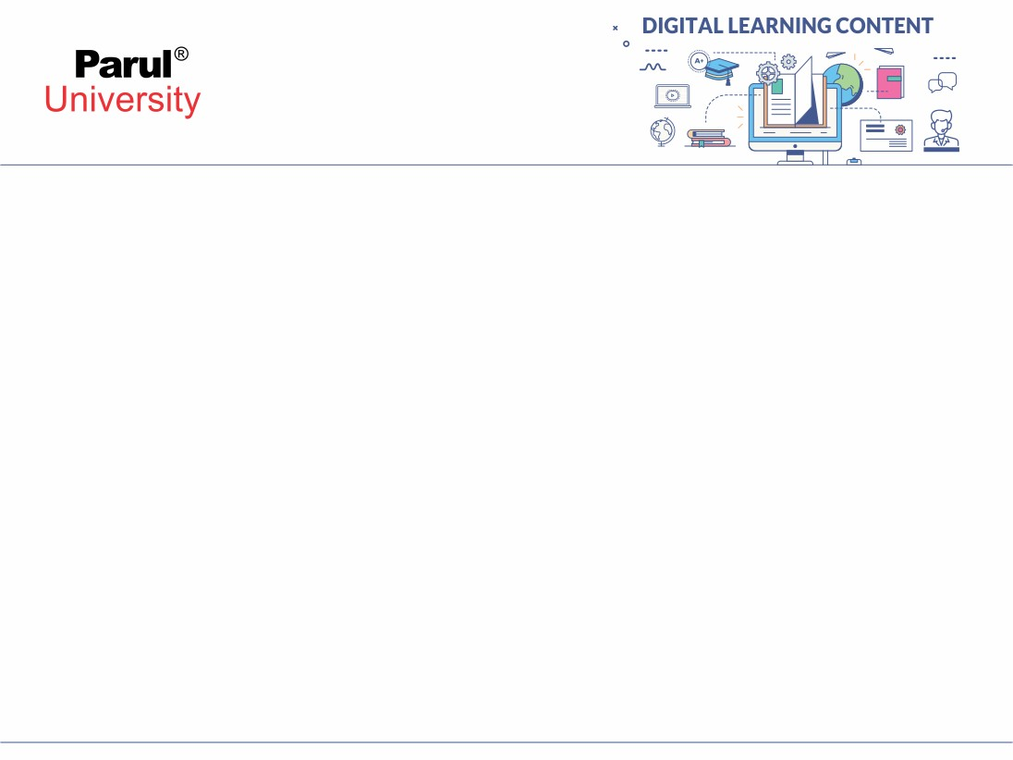

CHAPTER-4
Functions , Pointer Functions, Recursion , Storage classes:

Slide 3
Contents
Functions
Pointer Functions
Recursion
Storage classes

Slide 4
1. Function :
A function in C is a set of statements that when called perform some specific task.
It is the basic building block of a C program that provides modularity and code reusability. The programming statements of a function are enclosed within { } braces, having certain meanings and performing certain operations.
They are also called subroutines or procedures in other languages.

Slide 5
Syntax of Functions in C
The syntax of function can be divided into 3 aspects:
Function Declaration
Function Definition
Function Calls

Slide 6
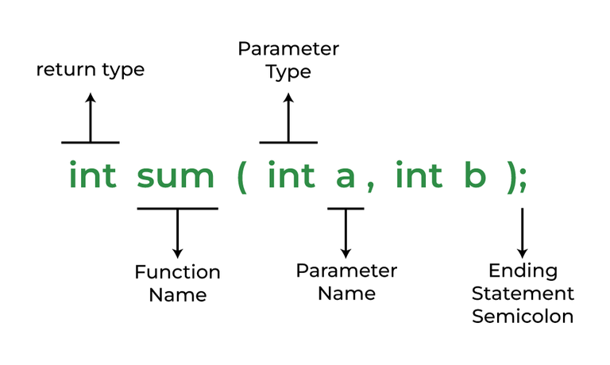
Function Declarations
The parameter name is not mandatory while declaring functions. We can also declare the function without using the name of the data variables.
In a function declaration, we must provide the function name, its return type, and the number and type of its parameters.
A function declaration tells the compiler that there is a function with the given name defined somewhere else in the program.
Syntax:
return_type name_of_the_function (parameter_1, parameter_2);

Slide 7
Function Definition
The function definition consists of actual statements which are executed when the function is called (i.e. when the program control comes to the function).
return_type function_name (para1_type para1_name, para2_type para2_name)
{
// body of the function
}
A C function is generally defined and declared in a single step because the function definition always starts with the function declaration so we do not need to declare it explicitly. The below example serves as both a function definition and a declaration.

Slide 8
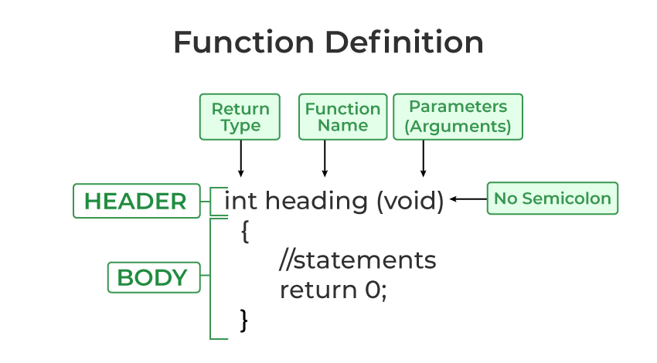
Structure :

Slide 9
Function Call:
A function call is a statement that instructs the compiler to execute the function. We use the function name and parameters in the function call.
In the below example, the first sum function is called and 10,30 are passed to the sum function. After the function call sum of a and b is returned and control is also returned back to the main function of the program.

Slide 10
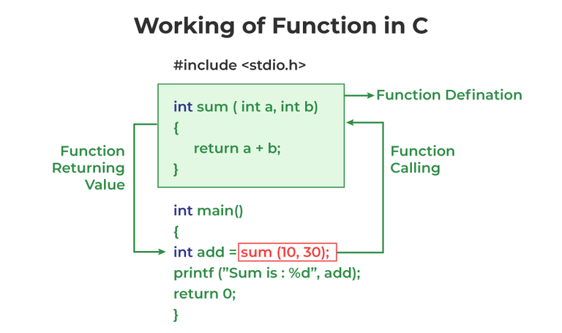
Working concept :
Note: Function call is neccessary to bring the program control to the function definition. If not called, the function statements will not be executed.

Slide 11
Example: :
// C program to show function
// call and definition
#include <stdio.h>
// Function that takes two parameters
// a and b as inputs and returns
// their sum
int sum(int a, int b)
{
return a + b;
}
// Driver code
int main()
{
// Calling sum function and
// storing its value in add variable
int add = sum(10, 30);
printf("Sum is: %d", add);
return 0;
}

Slide 12
Output
Sum is: 40
As we noticed, we have not used explicit function declaration. We simply defined and called the function.

Slide 13
Function Return Type
Function return type tells what type of value is returned after all function is executed. When we don’t want to return a value, we can use the void data type.
Example:
int func(parameter_1,parameter_2);
The above function will return an integer value after running statements inside the function.
Note: Only one value can be returned from a C function. To return multiple values, we have to use pointers or structures.

Slide 14
Function Arguments:
Function Arguments (also known as Function Parameters) are the data that is passed to a function.
Example:
int function_name(int var1, int var2);
Conditions of Return Types and Arguments
In C programming language, functions can be called either with or without arguments and might return values.
They may or might not return values to the calling functions.
Function with no arguments and no return value
Function with no arguments and with return value
Function with argument and with no return value
Function with arguments and with return value

Slide 15
How Does C Function Work?
Working of the C function can be broken into the following steps as mentioned below:
Declaring a function: Declaring a function is a step where we declare a function. Here we define the return types and parameters of the function.
Defining a function:
Calling the function: Calling the function is a step where we call the function by passing the arguments in the function.
Executing the function: Executing the function is a step where we can run all the statements inside the function to get the final result.
Returning a value: Returning a value is the step where the calculated value after the execution of the function is returned. Exiting the function is the final step where all the allocated memory to the variables, functions, etc is destroyed before giving full control to the main function.

Slide 16
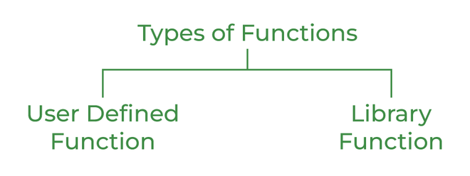
Types of Functions
There are two types of functions in C:
Library Functions
User Defined Functions

Slide 17
1. Library Function Flowchart of For Loop
A library function is also referred to as a “built-in function”. A compiler package already exists that contains these functions, each of which has a specific meaning and is included in the package. Built-in functions have the advantage of being directly usable without being defined, whereas user-defined functions must be declared and defined before being used.
For Example:
pow(), sqrt(), strcmp(), strcpy() etc.

Slide 18
Example: for loop
Advantages of C library functions
C Library functions are easy to use and optimized for better performance.
C library functions save a lot of time i.e, function development time.
C library functions are convenient as they always work.

Slide 19
Library Function
// C program to implement
// the above approach
#include <math.h>
#include <stdio.h>
// Driver code
int main()
{
double Number;
Number = 49;
// Computing the square root with
// the help of predefined C
// library function
double squareRoot = sqrt(Number);
printf("The Square root of %.2lf = %.2lf",
Number, squareRoot);
return 0;
}
Output
The Square root of 49.00 = 7.00

Slide 20
2. User Defined Function
Functions that the programmer creates are known as User-Defined functions or “tailor-made functions”. User-defined functions can be improved and modified according to the need of the programmer.
Whenever we write a function that is case-specific and is not defined in any header file, we need to declare and define our own functions according to the syntax.
Advantages of User-Defined Functions
Changeable functions can be modified as per need.
The Code of these functions is reusable in other programs.
These functions are easy to understand, debug and maintain.

Slide 21
User Defined Function Example:
// C program to show
// user-defined functions
#include <stdio.h>
int sum(int a, int b)
{
return a + b;
}
// Driver code
int main()
{
int a = 30, b = 40;
// function call
int res = sum(a, b);
printf("Sum is: %d", res);
return 0;
}
Output
Sum is: 70

Slide 22
Passing Parameters to Functions
The data passed when the function is being invoked is known as the Actual parameters.
In the below program, 10 and 30 are known as actual parameters.
Formal Parameters are the variable and the data type as mentioned in the function declaration.
In the below program, a and b are known as formal parameters.

Slide 23
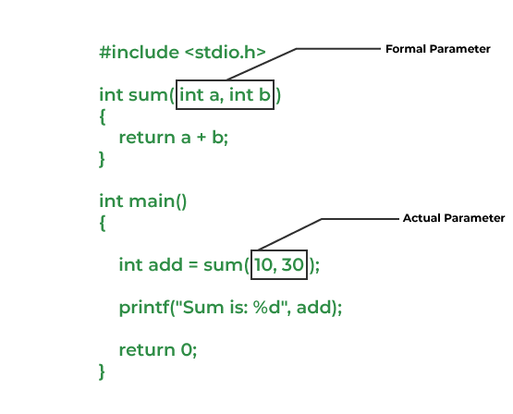
Example:

Slide 24
We can pass arguments to the C function in two ways:
Call by Value
call by Reference
1. Call by Value:
Parameter passing in this method copies values from actual parameters into formal function parameters. As a result, any changes made inside the functions do not reflect in the caller’s parameters.

Slide 25
call by Value example :
►
// C program to show use
// of call by value
#include <stdio.h>
void swap(int var1, int var2)
{
int temp = var1;
var1 = var2;
var2 = temp;
}
// Driver code
int main()
{
int var1 = 3, var2 = 2;
printf("Before swap Value of var1 and var2 is: %d, %d\n",
var1, var2);
swap(var1, var2);
printf("After swap Value of var1 and var2 is: %d, %d",
var1, var2);
return 0;
}
Before swap Value of var1 and var2 is: 3, 2
After swap Value of var1 and var2 is: 3, 2

Slide 26
2. Call by Reference
►
The caller’s actual parameters and the function’s actual parameters refer to the same locations, so any changes made inside the function are reflected in the caller’s actual parameters.
We will discuss with this by an example :

Slide 27
Example :
// C program to show use of
// call by Reference
#include <stdio.h>
void swap(int *var1, int *var2)
{
int temp = *var1;
*var1 = *var2;
*var2 = temp;
}
// Driver code
int main()
{
int var1 = 3, var2 = 2;
printf("Before swap Value of var1 and var2 is: %d, %d\n",
var1, var2);
swap(&var1, &var2);
printf("After swap Value of var1 and var2 is: %d, %d",
var1, var2);
return 0;
}
►
►

Slide 28
Output :
Output
Before swap Value of var1 and var2 is:
3, 2
After swap Value of var1 and var2 is: 2, 3

Slide 29
Advantages of Functions in C
Functions in C is a highly useful feature of C with many advantages as mentioned below:
The function can reduce the repetition of the same statements in the program.
The function makes code readable by providing modularity to our program.
There is no fixed number of calling functions it can be called as many times as you want.
The function reduces the size of the program.
Once the function is declared you can just use it without thinking about the internal working of the function.

Slide 30
Disadvantages of Functions in C
The following are the major disadvantages of functions in C:
Cannot return multiple values.
Memory and time overhead due to stack frame allocation and transfer of program control.

Slide 31
Function Pointer in C
In C, like normal data pointers (int *, char *, etc), we can have pointers to functions. Following is a simple example that shows declaration and function call using function pointer.
#include <stdio.h>
// A normal function with an int parameter
// and void return type
void fun(int a)
{
printf("Value of a is %d\n", a);
}
int main()

Slide 32
Continue…
{
// fun_ptr is a pointer to function fun()
void (*fun_ptr)(int) = &fun;
/* The above line is equivalent of following two
void (*fun_ptr)(int);
fun_ptr = &fun;
*/
// Invoking fun() using fun_ptr
(*fun_ptr)(10);
return 0;
}
Output:
Value of a is 10

Slide 33
Calling A function through function pointer
Calling a function using a pointer is similar to calling a function in the usual way using the name of the function.
Suppose we declare a function and its pointer as given below.
int (*pointer) (int); // function pointer declaration
int areaSquare (int); // function declaration
pointer = areaSquare;

Slide 34
Example :
To call the function areaSquare, we can create a function call using any of the three ways
int length = 5;
// Different ways to call the function
// 1. using function name
int area = areaSquare(length);
// 2. using function pointer (a)
int area = (*pointer)(length);
// 3. using function pointer (b)
int area = pointer(length);

Slide 35
The effect of calling functions using pointers or using their name is the same. It is not compulsory to call the function with the indirection operator (*) as shown in the second case but it is good practice to use the indirection operator to clear out that function is called using a pointer as (*pointer)() is more readable when compared to calling function from pointers with parentheses pointer().

Slide 36
Passing A function's address as an Argument to other function
We cannot pass the function as an argument to another function.
But we can pass the reference of a function as a parameter by using a function pointer.
This process is known as call by reference as the function parameter is passed as a pointer that holds the address of arguments.
Therefore, C programming allows you to create a pointer pointing to the function, which can be further passed as an argument to the function.
We can create a function pointer as follows:
(type) (*pointer_name)(parameter);

Slide 37
Let's see a simple example of how we can pass the function pointer as a parameter.
void display(void (*p)())
{
for(int i=1;i<=5;i++)
{
p(i);
}
}
void print_numbers(int num)
{
cout<<num
}
int main()
{
void (*p)(int); // void function pointer declaration
printf("The values are :");
display(print_numbers);
return 0;
}

Slide 38
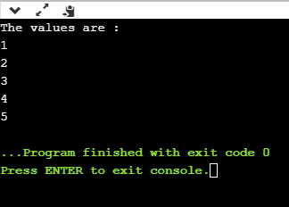
Output :

Slide 39
Types of Pointer function Creation
The type of a pointer to a function is based on both the return type and parameter types of the function. In the first declaration, f is interpreted as a function that takes an int as argument, and returns a pointer to an int .
Dangling pointer
Dangling pointer is a pointer pointing to a memory location that has been freed (or deleted). There are different ways where Pointer acts as dangling pointer

Slide 40
Function Call
The pointer pointing to local variable becomes dangling when local variable is not static.
int *show(void) {
int n = 76; /* ... */ return &n;
}
Output:
Output of this program will be garbage address.

Slide 41
Void pointer
Void pointer is a pointer which is not associate with any data types. It points to some data location in storage means points to the address of variables. It is also called general purpose pointer.
It has some limitations:
Pointer arithmetic is not possible of void pointer due to its concrete size.
It can’t be used as dereferenced.

Slide 42
#include<stdlib.h>
#include<iostream>
using namespace std;
int main() {
int a = 7;
float b = 7.6;
void *p;
p = &a;
cout<<*( (int*) p)<<endl ;
p = &b;
cout<< *( (float*) p) ;
return 0;
}

Slide 43
Output
7
7.600000

Slide 44
Recursion:
Recursion is the process of repeating items in a self-similar way. In programming languages, if a program allows you to call a function inside the same function, then it is called a recursive call of the function.
void recursion() {
recursion(); /* function calls itself */
}
int main() {
recursion();
}

Slide 45
The C programming language supports recursion, i.e., a function to call itself. But while using recursion, programmers need to be careful to define an exit condition from the function, otherwise it will go into an infinite loop.
Recursive functions are very useful to solve many mathematical problems, such as calculating the factorial of a number, generating Fibonacci series, etc.
Number Factorial
The following example calculates the factorial of a given number using a recursive function

Slide 46
#include <stdio.h>
unsigned long long int factorial(unsigned int i) {
if(i <= 1) {
return 1;
}
return i * factorial(i - 1);
}
int main() {
int i = 12;
printf("Factorial of %d is %d\n", i, factorial(i));
return 0;
}

Slide 47
What is Tail Recursion
Tail recursion is defined as a recursive function in which the recursive call is the last statement that is executed by the function. So basically nothing is left to execute after the recursion call.
// An example of tail recursive function
void print(int n)
{
if (n < 0)
return;
printf("%d ", n);
// The last executed statement is recursive call
print(n - 1);
}

Slide 48
Tree recursion : Recursion
Tree Recursion is just a phrase to describe when you make a recursive call more than once in your recursive case. The fibonacci function is a good example of Tree recursion. The time complexity of tree recursive function is not linear, they run in exponential time.
function doSomething(n) {
// base case to stop recursion
if n is less than 2:
return n;
// here is some instructions
// recursive step
return doSomething(n-1) + doSomething(n-2);
}

Slide 49
Head Recursion:
If a recursive function calling itself and that recursive call is the first statement in the function then it’s known as Head Recursion. There’s no statement, no operation before the call. The function doesn’t have to process or perform any operation at the time of calling and all operations are done at returning time.

Slide 50
Example :
#include <stdio.h>
void fun(int n)
{
if (n > 0) {
fun(n - 1);
printf("%d ", n);
}
}
int main()
{
int x = 3;
fun(x);
return 0;
}

Slide 51
Storage classes:
C Storage Classes are used to describe the features of a variable/function. These features basically include the scope, visibility, and lifetime which help us to trace the existence of a particular variable during the runtime of a program.

Slide 52
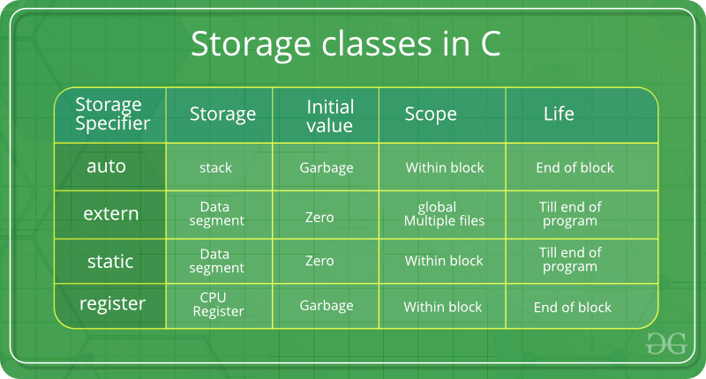

Slide 53
Auto:
This is the default storage class for all the variables declared inside a function or a block.
Hence, the keyword auto is rarely used while writing programs in C language.
Auto variables can be only accessed within the block/function they have been declared and not outside them (which defines their scope).
Of course, these can be accessed within nested blocks within the parent block/function in which the auto variable was declared

Slide 54
2. extern
Extern storage class simply tells us that the variable is defined elsewhere and not within the same block where it is used.
Basically, the value is assigned to it in a different block and this can be overwritten/changed in a different block as well.
So an extern variable is nothing but a global variable initialized with a legal value where it is declared in order to be used elsewhere. It can be accessed within any function/block.

Slide 55
3. static
This storage class is used to declare static variables which are popularly used while writing programs in C language.
Static variables have the property of preserving their value even after they are out of their scope! Hence, static variables preserve the value of their last use in their scope.
So we can say that they are initialized only once and exist till the termination of the program.
Thus, no new memory is allocated because they are not re-declared.
Their scope is local to the function to which they were defined. Global static variables can be accessed anywhere in the program. By default, they are assigned the value 0 by the compiler.

Slide 56
4. register
This storage class declares register variables that have the same functionality as that of the auto variables.
The only difference is that the compiler tries to store these variables in the register of the microprocessor if a free register is available.
This makes the use of register variables to be much faster than that of the variables stored in the memory during the runtime of the program.
If a free registration is not available, these are then stored in the memory only. Usually, a few variables which are to be accessed very frequently in a program are declared with the register keyword which improves the running time of the program.
An important and interesting point to be noted here is that we cannot obtain the address of a register variable using pointers.

